Slide 1
Signature verification system project
INTERNSHIP PROGRAM:
Infosys Springboard AIML Internship
NAME: CH.V.S.S.SUREKHA

Slide 2
INTRODUCTION:
The Signature Verification System is a machine learning-based project that aims to accurately distinguish between genuine and forged signatures.
Signature verification is a key aspect of identity authentication and fraud prevention in numerous fields , particularly in financial sector.
This project focuses on developing a robust signature verification model using advanced machine learning techniques.

Slide 3
PROJECT OBJECTIVES:
The main goal of this project is to develop a robust signature verification system that can automatically verify the authenticity of signatures by distinguishing between genuine and forged ones. The system must be able to:
Achieve high accuracy in identifying signatures.
Minimize false positive and false negative rates, ensuring that genuine signatures are correctly validated and forgeries are rejected.
Handle different variations of signatures, such as those with slight distortions, different writing styles, and varying levels of pressure.
Integrate with financial applications and improve security measures in banking systems.

Slide 4
Technology Stack:
Programming Language: Python
Framework: Django for web application development.
Machine Learning Libraries: TensorFlow/Keras for deep learning, Scikit-learn for data preprocessing and evaluation.
Database: SQLite for storing user data and signatures.

Slide 5
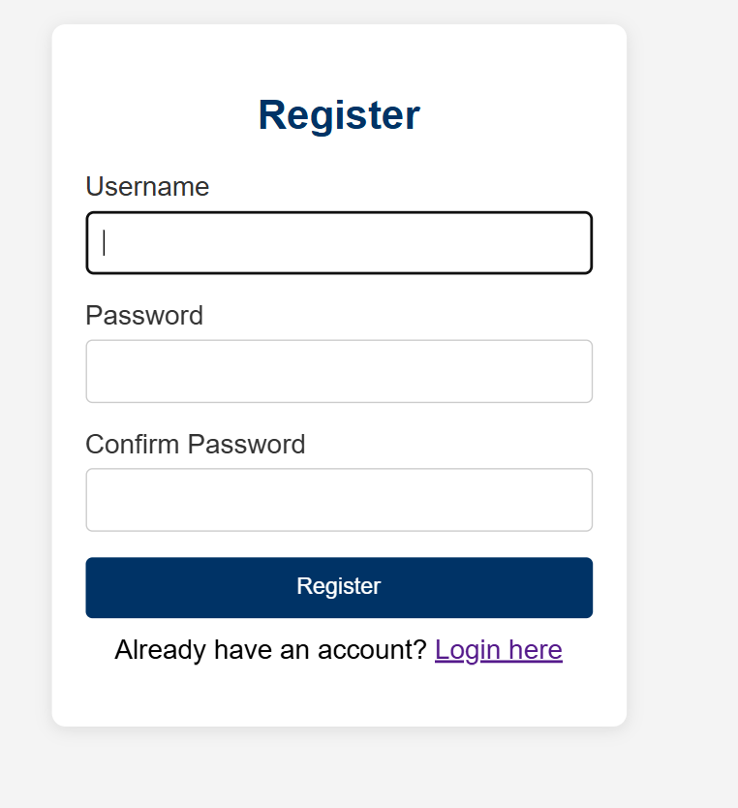
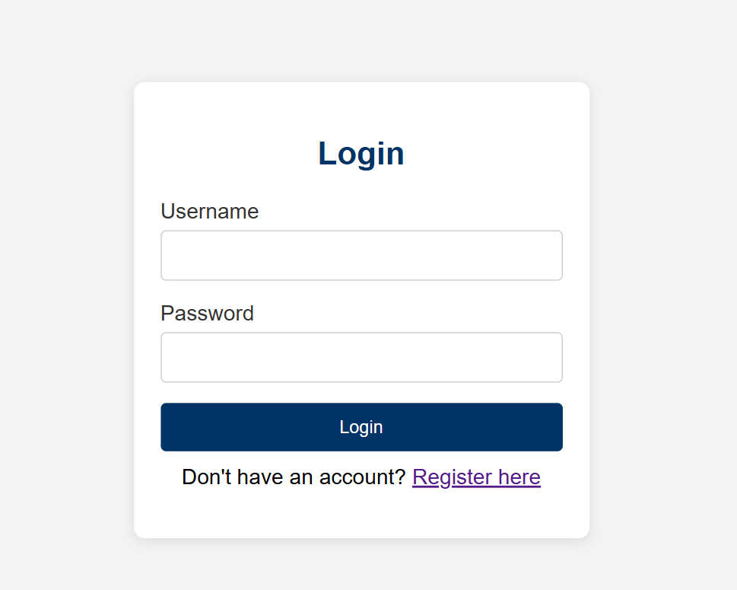
WORKFLOW OVERVIEW:

Slide 6
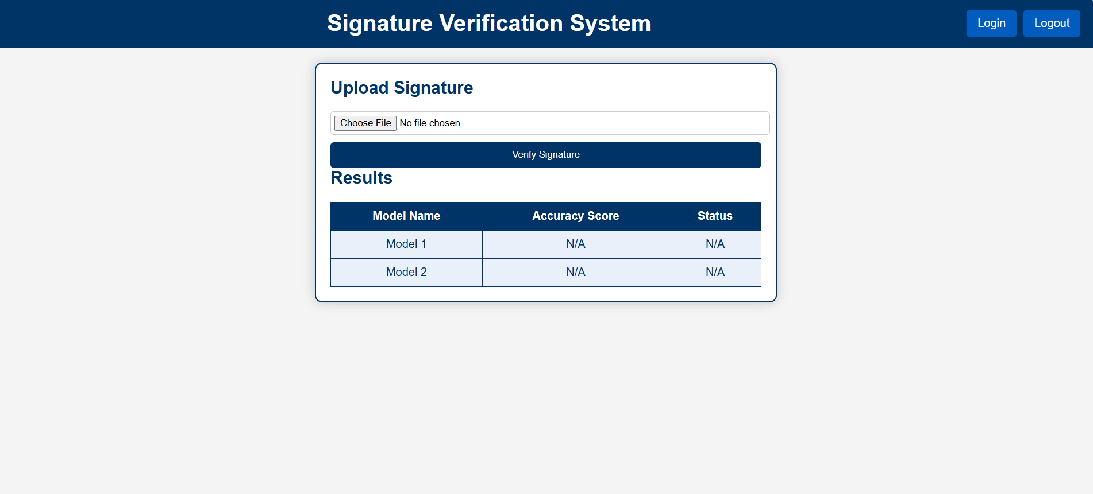
HOME PAGE:(FOR UPLOADING SIGNATURE)

Slide 7
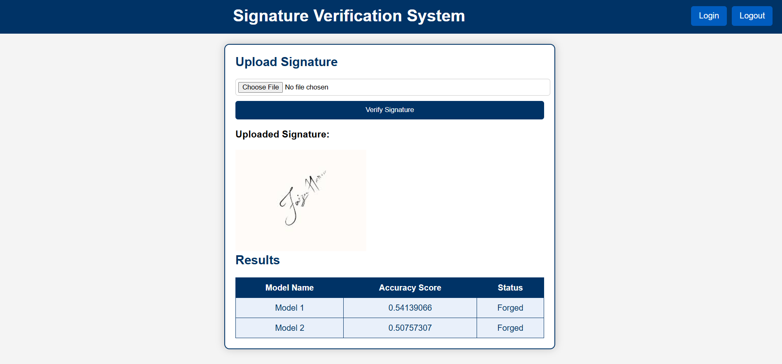
RESULT :(AFTER UPLOADING AND VERIFYING )

Slide 8
FUTURE WORK:
In future iterations of the project, the following improvements could be considered:
Model Optimization: Further hyperparameter tuning and exploration of other deep learning architectures, such as Transformers or Attention Mechanisms, could improve accuracy.
Real-Time Verification: The system could be adapted to perform real-time verification, where signatures are analyzed instantly as they are drawn or input.
Multimodal Authentication: The system could be enhanced to include multimodal biometric authentication, combining signature verification with other forms like facial recognition or fingerprint scanning.

Slide 9
CONCLUSION:
This Signature Verification System project successfully developed a machine learning model capable of distinguishing between genuine and forged signatures with high accuracy.
The use of CRNN and Bidirectional RNNs provided an effective solution for handling both the spatial and sequential nature of signature data.
The project demonstrates the potential for machine learning to improve security and fraud prevention in areas that rely on signature verification.
Future work could involve expanding the dataset to include more diverse signatures, improving model robustness, and integrating the system with real-world applications for enhanced security in digital transactions.

